Slide 1
GUI Construction on Numerical Methods & Crop Yield Estimation Classes
A MATLAB GUI project developed by Group 19 to create user-friendly interfaces for solving complex engineering problems. This presentation details the development of two integrated graphical user interfaces: one for numerical methods computation and another for agricultural yield prediction.

Slide 2
Project Overview & Objectives
Numerical Methods GUI
Yield Estimation GUI
Simplify complexity of mathematical coding
Model and predict crop productivity
Serve as practical decision-making tool for agricultural stakeholders
Compare and validate different solution techniques
Make complex agricultural modeling accessible to wide audiences
Maximize efficiency in problem-solving
Support four core methods: Euler, Runge-Kutta, Newton-Raphson, and Secant
Integrate five key environmental metrics in estimation
Utilize a MATLAB toolbox in this project

Slide 3
Design Process & Methodology
01
02
Research & Planning
Input/Output Design
Organized team meetings to review lecture notes and modules, establishing foundational concepts for GUI development.
Established necessary input parameters and planned output structure for each GUI interface.
03
04
Algorithm Development
Collaborative Refinement
Explored different ideologies, flowcharts, and pseudocodes before implementing final scripts.
Inquired from other groups about progress and refined ideas based on peer feedback.
05
06
Implementation & Testing
Documentation
Wrote code for both GUIs and conducted debugging sessions with all available team members.
Completed comprehensive report writing and presentation drafting.

Slide 4
Numerical Methods GUI Architecture
The Numerical Methods GUI features a main window (840x420 pixels) with dedicated input fields for mathematical functions and parameters. Users input the function f(x,y) or f(x), derivative f'(x), initial conditions (x₀, y₀), step size (h), end point (x_end), and tolerance values. The interface includes four method buttons—Euler, Runge-Kutta, Newton-Raphson, and Secant—each triggering specific computational functions. Results display in a dedicated text area output.

Slide 5
Numerical Methods Implementation
Euler Method
Runge-Kutta Method
Solves ordinary differential equations using first-order approximation with step-by-step integration.
Higher-order method providing improved accuracy for ODE solutions through weighted average calculations.
Newton-Raphson Method
Secant Method
Finds equation roots using iterative refinement based on function derivatives for rapid convergence.
Root-finding technique requiring two initial points without explicit derivative calculation.
Each method executes through separate classes that compute and display numerical solutions efficiently.

Slide 6
Yield Estimation GUI Design
The Yield Estimation GUI (840x420 pixels) provides an intuitive platform for agricultural prediction. Users input five key environmental metrics: Rainfall (mm), Fertilizer application rate (kg/ha), Soil Quality Index (0-10 scale), average daily Sunlight (hours/day), and total Farm Size (hectares). The integrated YieldModel object processes these inputs and instantly generates predicted crop yield output, enabling stakeholders to make informed agricultural decisions based on environmental conditions.

Slide 7
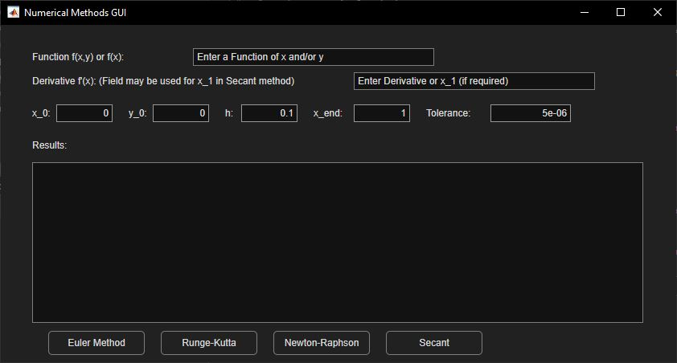
GUI Implementation & Results
The three GUIs demonstrate successful implementation of both numerical methods and agricultural modeling, with functional buttons, input validation, and comprehensive output displays.

Slide 8
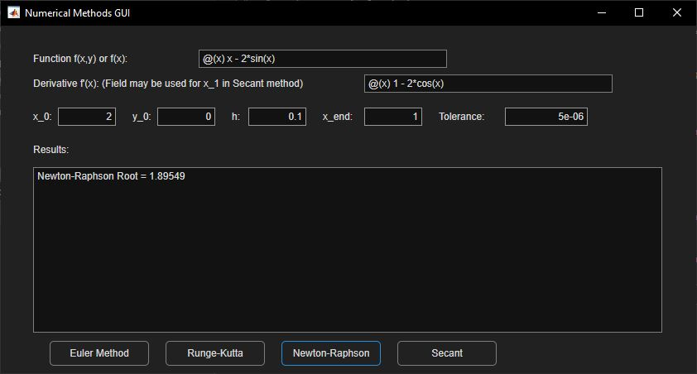
GUI Implementation & Results(cont.)
This figure shows the output of the interface after inputting the data.

Slide 9
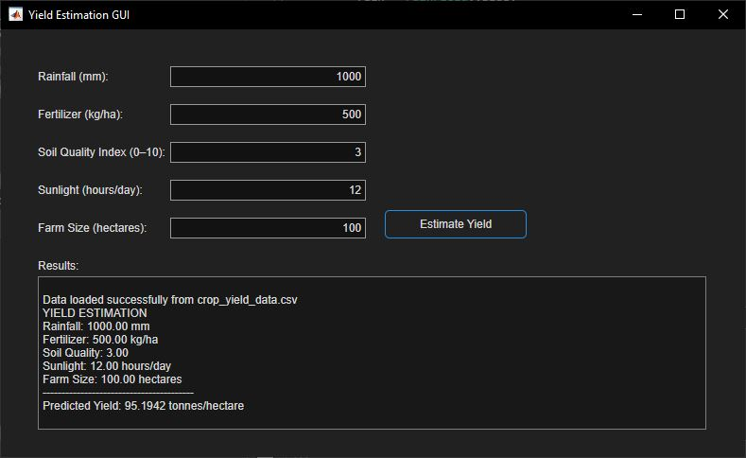
GUI Implementation & Results(cont.)
This figure shows the output of the yield interface after inputting the data

Slide 10
Technical Challenges & Solutions
Function-Button Integration
Power Supply Issues
Challenge: Connecting specific numerical method functions to individual buttons. Solution: Applied MATLAB documentation knowledge to properly map button callbacks to corresponding computational functions.
Challenge: Unstable power supply reduced effective coding time and productivity. Solution: Implemented regular code backups and adapted work schedule to accommodate infrastructure limitations.

Slide 11
Project Achievements
1
Platforms
2
User-Friendly Interface
3
Real-World Application
Successfully created two integrated GUIs addressing both computational mathematics and practical agricultural applications.
Developed accessible interfaces that abstract complex mathematical and machine learning operations for diverse user audiences.
Demonstrated practical implementation of numerical methods and predictive modeling for solving authentic engineering and agricultural problems.

Slide 12
Conclusion & Impact
This project successfully demonstrates the practical application of numerical methods and machine learning to solve real-world engineering and agricultural challenges. The Numerical Methods GUI provides a user-friendly platform for implementing core computational algorithms including Euler, Runge-Kutta, Newton-Raphson, and Secant methods. The Yield Estimation GUI showcases specialized machine learning application in agricultural engineering by integrating rainfall, fertilizer, soil quality, sunlight, and farm size into a predictive model. Together, these GUIs offer practical support systems for engineers and agricultural stakeholders, making complex computational and predictive processes accessible and efficient.

